Slide 1
First Time Home Buyers Workshop
Presented By Ernest D. Harris

Slide 2
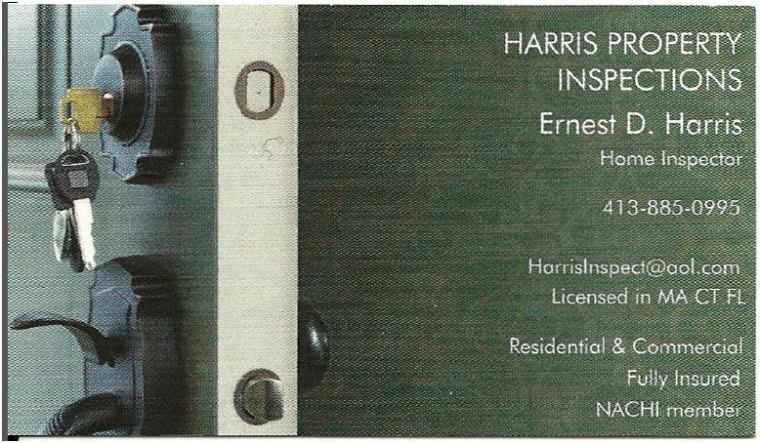

Slide 4
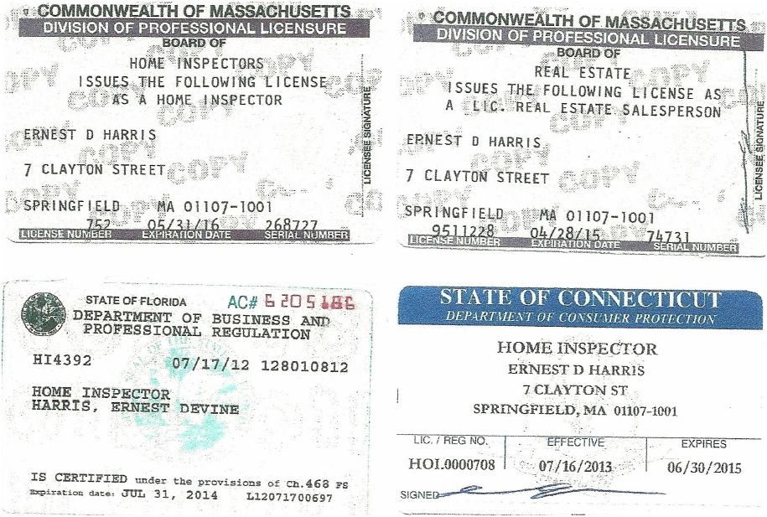

Slide 5
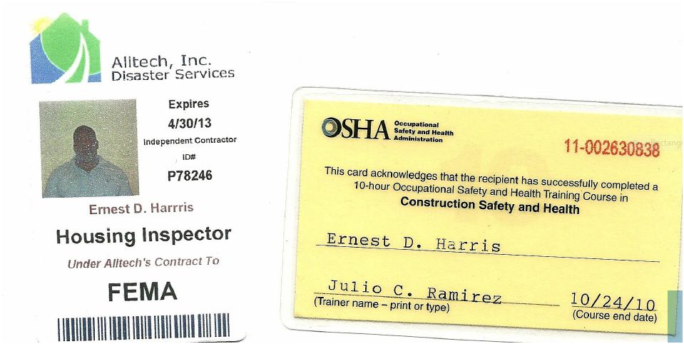

Slide 6
After Your Offer Is Accepted

Slide 7
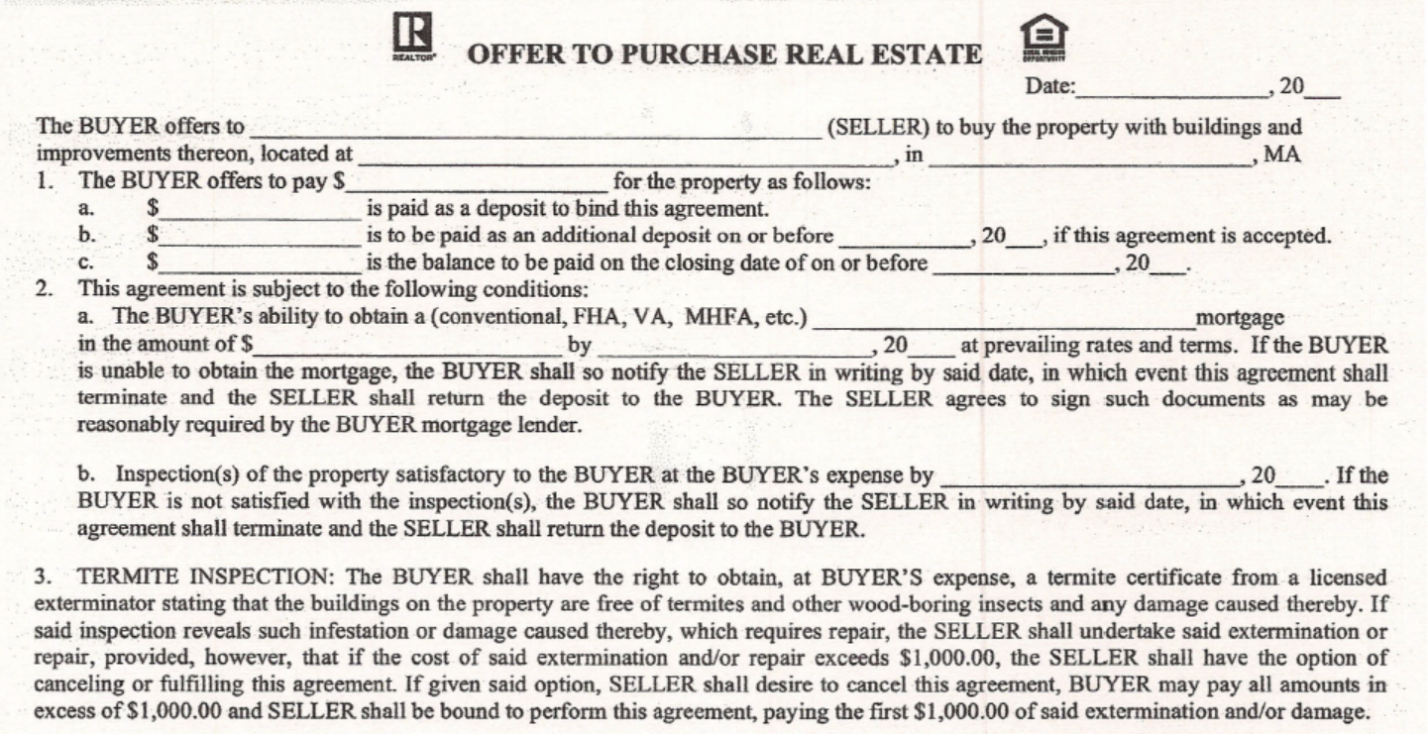

Slide 8
Your offer on your new home has been accepted. These are the things you need to do between now and the closing date.
Within the First 10 Days of Acceptance
Contact your mortgage person to apply for your mortgage. The mortgage person will begin the financial process and order an appraisal for your new home.
Order your home inspection. A home inspection is not required, but highly recommended. This will no doubt be the largest purchase you make. Spending a couple of hundred dollars to have a qualified person thoroughly inspect your future home may prevent thousands of dollars of unexpected repairs later on. Contact a licensed home inspector of your choice (if you are working with a "buyers agent", then he/she may recommended one). The home inspector will set an appointment that is convenient for you. The inspection must take place during your inspection period, usually 10 days from acceptance of your offer.

Slide 9
Arrange for the second deposit. The second deposit on your new home is usually due 10 days from the date of your offer. This is normally 5% of the purchase price, but could be significantly less depending on your financing and your available funds. This must be made by bank check, certified check or money order. If you need to transfer funds from a retirement or money market account, or borrowing money from a relative, do it as soon as possible to allow time for the check to clear.
Have the purchase and sale agreement reviewed by your attorney. Although not required, having an attorney familiar with real estate law will save you peace of mind and possibly money should any legal issues come up. An attorney will help to make sure you are financially protected should anything go wrong during the home buying process.
Sign the Purchase and Sale Agreement. The is the contract that contains all the details of the real estate purchase. Occasionally, this may take place beyond the 10 day period if there are any concerns that are being negotiated between the buyer and seller.
Inform your landlord you are purchasing a home if you are renting. Most landlords require at least 30 days notice that you are moving or you may forfeit any deposits you have on your apartment.

Slide 10
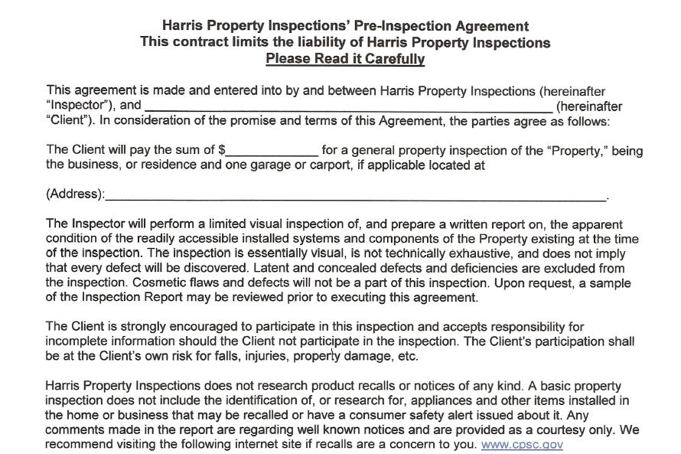

Slide 11
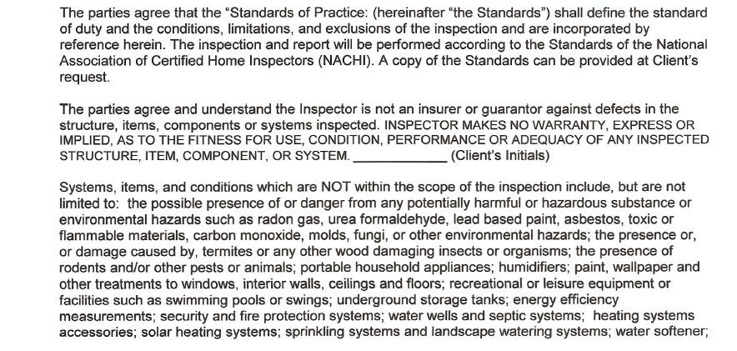

Slide 12
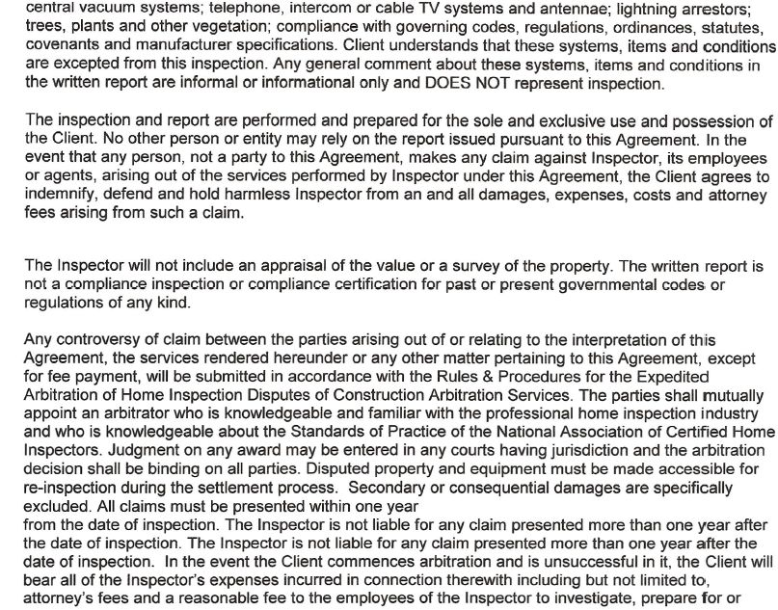

Slide 13
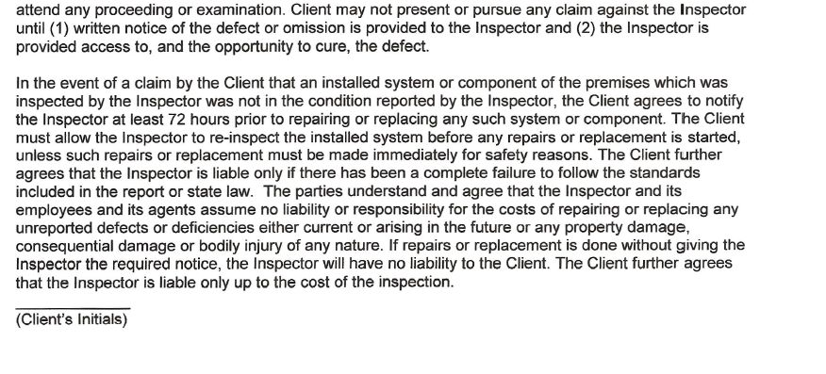

Slide 14
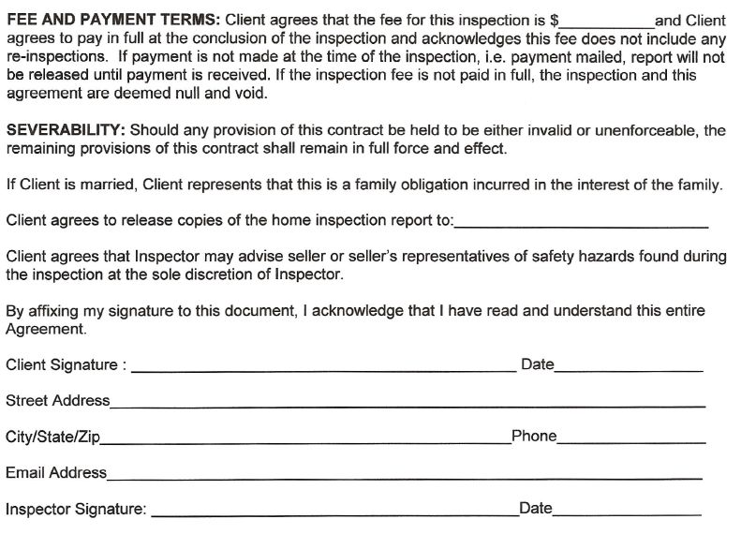

Slide 15
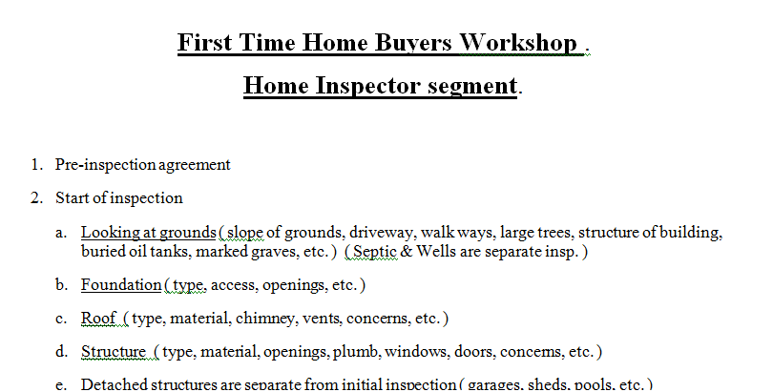

Slide 16
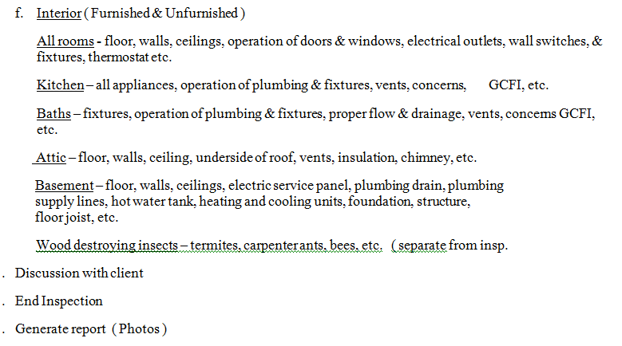

Slide 17
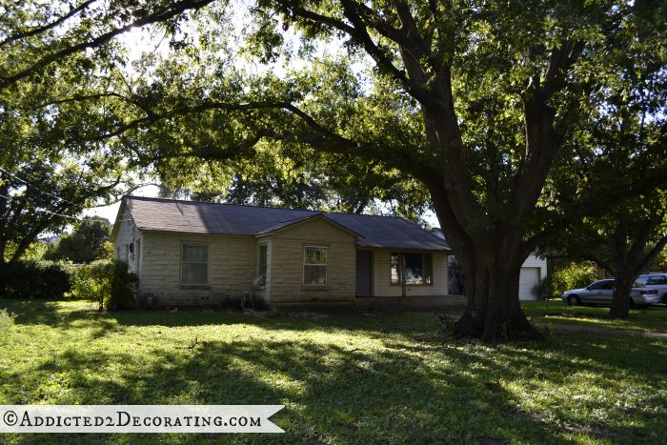
Notes:
Large Tree On Front Lawn

Slide 18
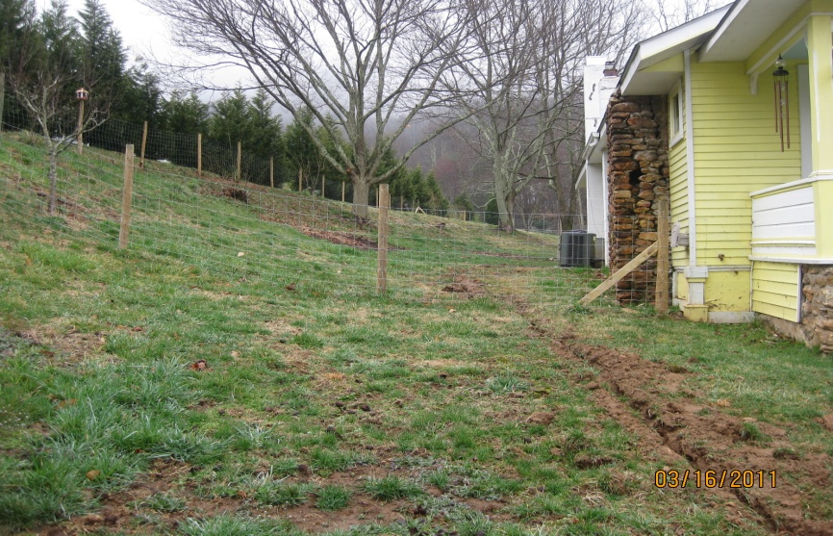
Notes:
Negative slope toward home

Slide 19
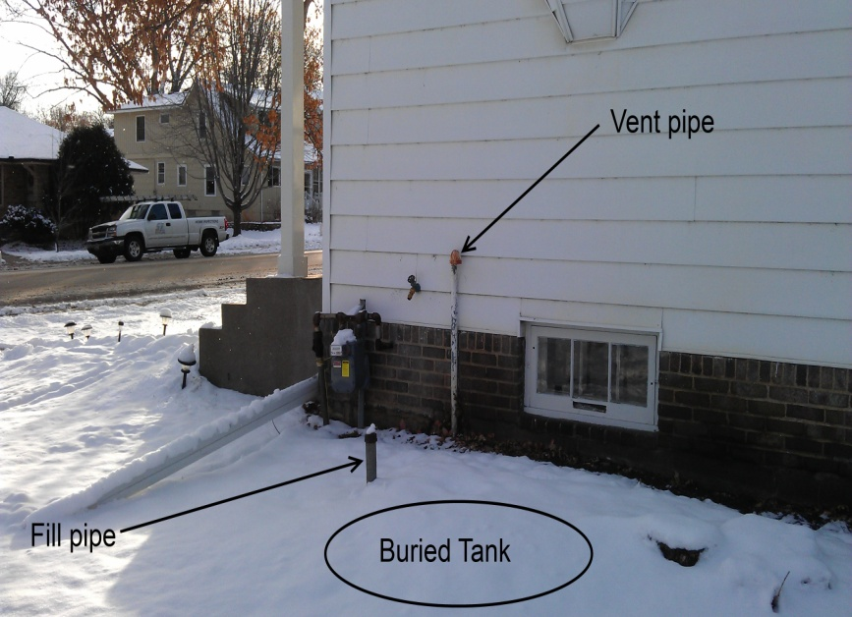
Notes:
Underground oil storage tank

Slide 20
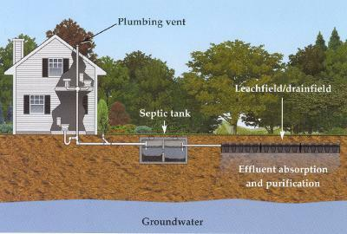
Notes:
Home sewage septic system

Slide 21
Notes:
Home well water well head

Slide 22
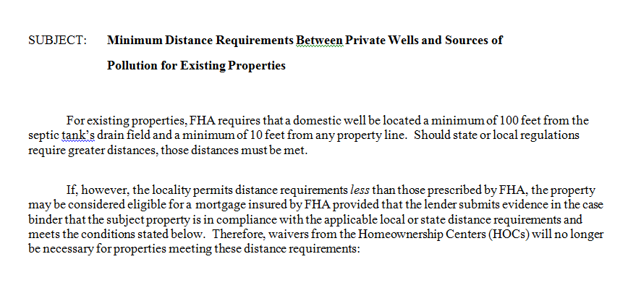

Slide 23
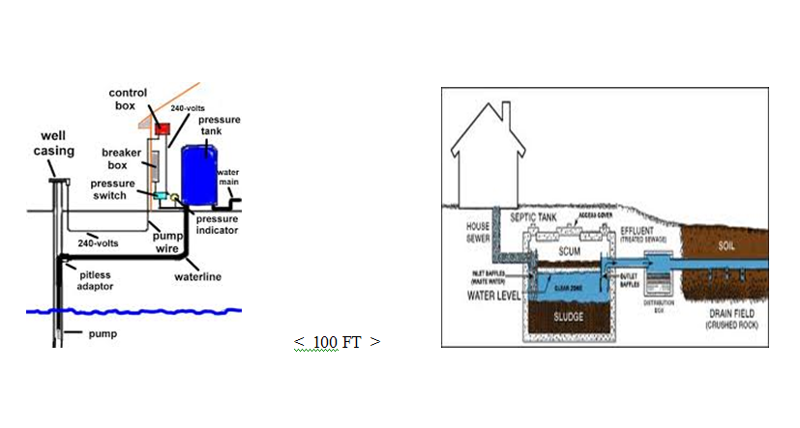
Notes:
FHA requirements – but many towns have their codes

Slide 24
Notes:
Framing / decking of older Roof.

Slide 25
Notes:
Deteriorating asphalt shingles

Slide 26
Notes:
Tiled roof with skylights

Slide 27
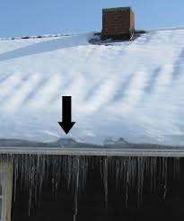
Notes:
Snow covered roof with ice damming.

Slide 28
Notes:
Snow covered roof weight on Roof.

Slide 29
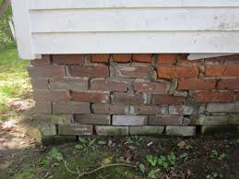
Notes:
Crumbling brick foundation

Slide 30
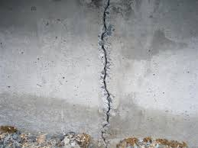
Notes:
Vertical crack in foundation wall

Slide 31
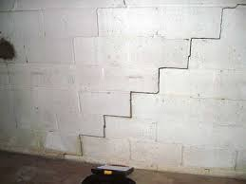
Notes:
Step crack in foundation wall

Slide 32
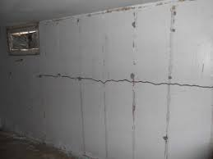
Notes:
Horizontal crack in foundation wall

Slide 33
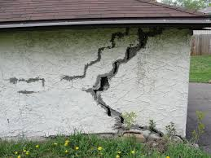
Notes:
Major crack in wall

Slide 34
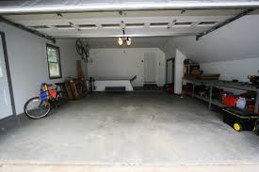
Notes:
Garage with overhead door

Slide 35
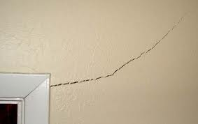
Notes:
Crack at header of interior door

Slide 36
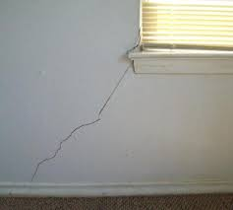
Notes:
Crack at base of interior window

Slide 37
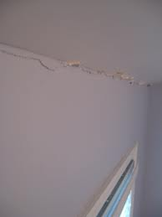
Notes:
Crack at ceiling / wall joint

Slide 38
Notes:
Room – check flooring, walls, ceiling, windows doors, outlets, switches, and Fireplace

Slide 39
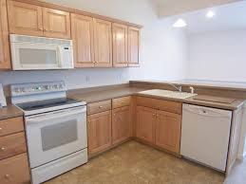
Notes:
Typical kitchen with appliances

Slide 40
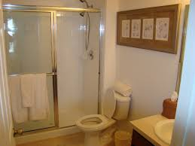
Notes:
Typical 3 piece bathroom

Slide 41
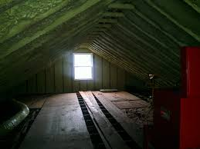
Notes:
Top insulated attic

Slide 42
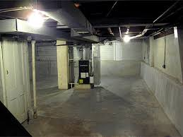
Notes:
Open basement with HVAC

Slide 43
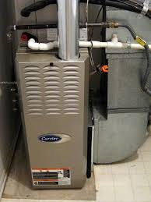
Notes:
Forced air funance

Slide 44
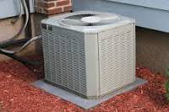
Notes:
Air Condensor

Slide 45
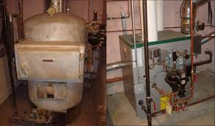
Notes:
Boilers – Older and Newer

Slide 46
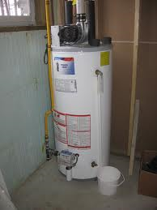
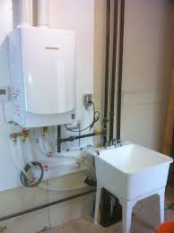
Notes:
Tank and Tankless hot water heaters

Slide 47
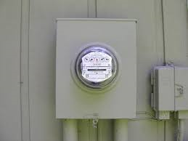
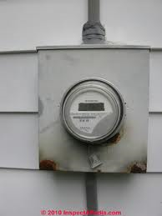
Notes:
Underground and Overhead electric meters

Slide 48
Notes:
Circuit breaker panel

Slide 49
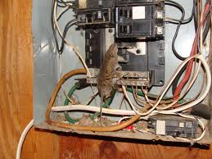
Notes:
Inside Electrical panel poor wiring with open knockouts

Slide 50
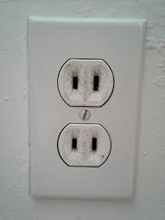
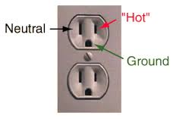
Notes:
Older 2 prong outlets and Newer 3 prong outlets

Slide 51
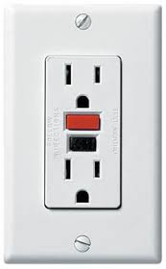
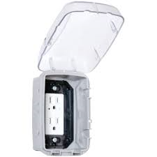
Notes:
Indoor GCFI outlet and outdoor with cover

Slide 52
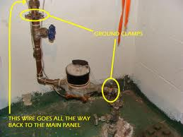
Notes:
Water Main with meter

Slide 53
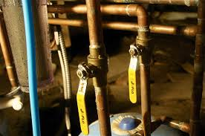
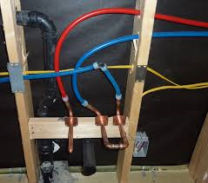
Notes:
Copper supply lines and Pex supply lines

Slide 54
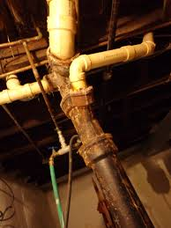
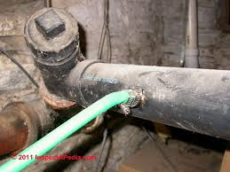
Notes:
Sewage drains

Slide 55
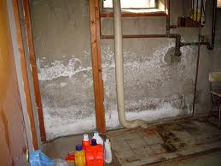
Notes:
Efflorescence on basement walls

Slide 56
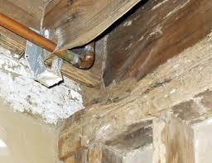
Notes:
Termite damage to floor joist and white mold

Slide 57
Notes:
Termite damage to tree

Slide 58
Notes:
Carpenter ant damage

Slide 59
Notes:
Powderpost beetle damage

Slide 60
Notes:
Termite and Powderpost beetle

Slide 61
Notes:
Exterior wasp nest at soffit

Slide 62
Notes:
Interior wasp nest in attic

Slide 66
Notes:
Asbestos Material

Slide 68
Inspection Report

